Slide 1



Lime and Acid Reactions: A Detailed Exploration
This presentation dives into the fascinating world of lime and acid reactions. We'll explore the chemical properties of these substances, understand how they interact, and delve into the applications of this reaction in various industries.
by Nghia Dinh

Slide 2
Understanding Lime (Calcium Oxide)
Chemical Formula
Properties
Applications
Lime is a white, alkaline compound with the formula CaO.
It is highly reactive and readily absorbs water from the atmosphere, a process called hydration.
Lime is widely used in construction, agriculture, and environmental remediation.

Slide 3

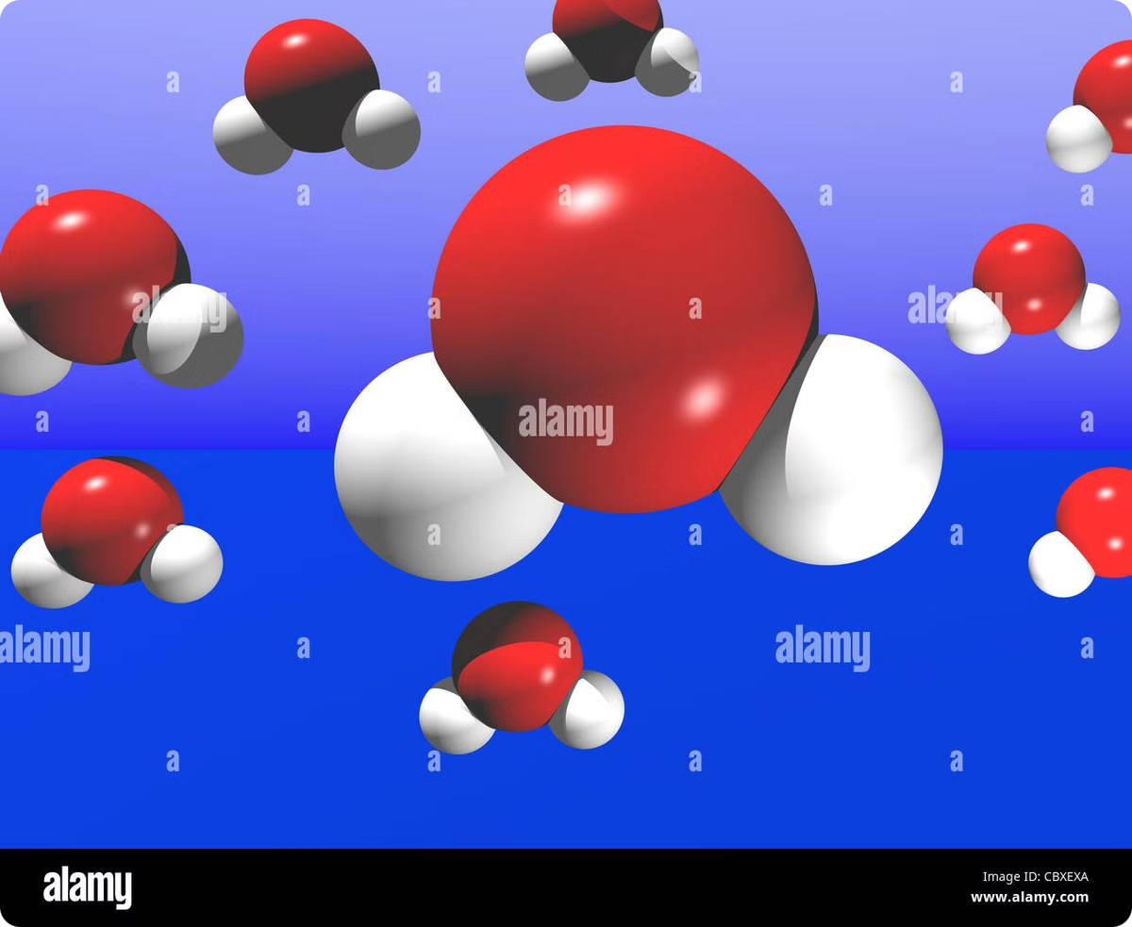



The Role of Water in the Lime-Acid Reaction
Hydration
Lime reacts with water to form calcium hydroxide (Ca(OH)2), also known as slaked lime.
Hydroxide Formation
The formation of calcium hydroxide is a highly exothermic reaction that releases heat.
Reaction with Acid
Calcium hydroxide is then ready to react with acid, leading to neutralization.

Slide 4


Neutralization Reaction: Lime and Acid
Lime (CaO)
Acid (HCl)
Base
Acid
pH greater than 7
pH less than 7

Slide 5

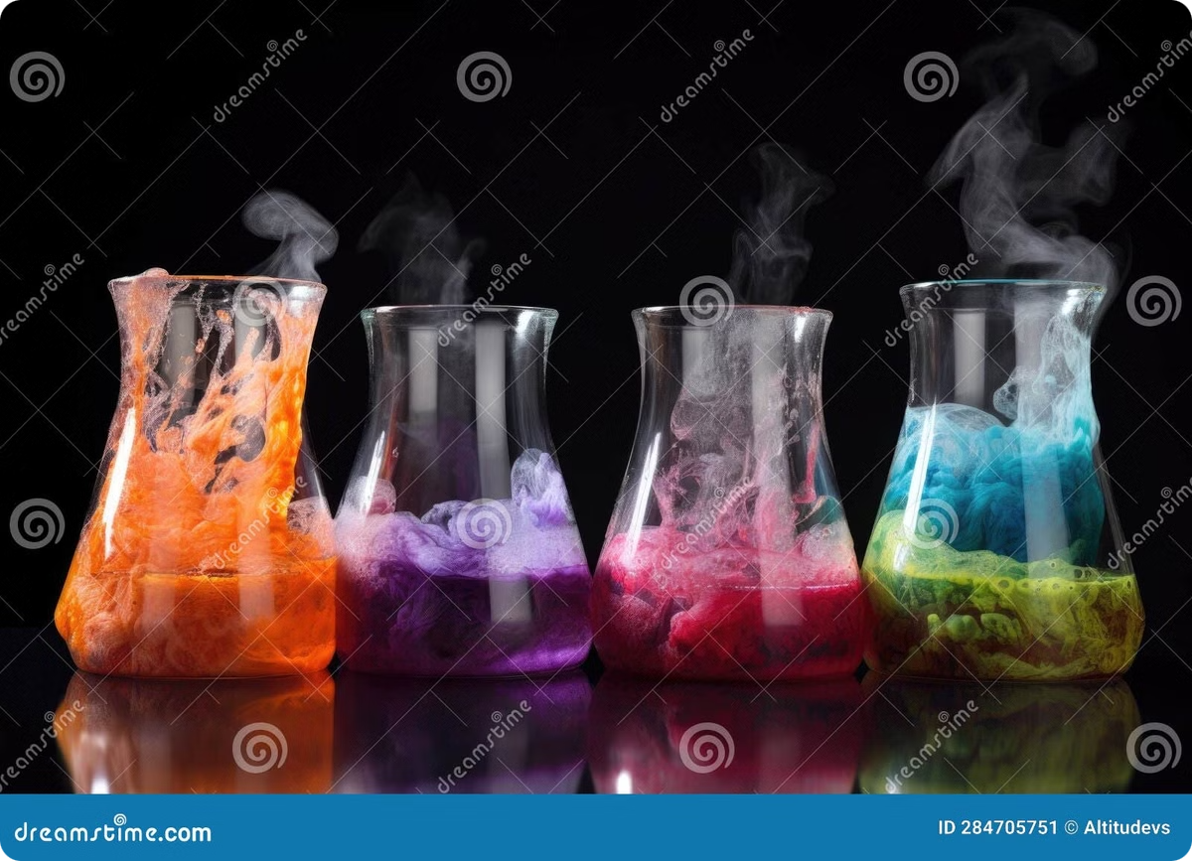
Factors Affecting the Lime-Acid Reaction Rate
1
Concentration
2
Temperature
Higher concentrations of lime and acid lead to a faster reaction rate.
Increasing the temperature accelerates the reaction by providing more energy for molecules to collide.
3
Surface Area
4
Presence of Catalysts
A larger surface area of lime exposed to the acid enhances the reaction rate.
Certain catalysts can speed up the reaction without being consumed in the process.

Slide 6

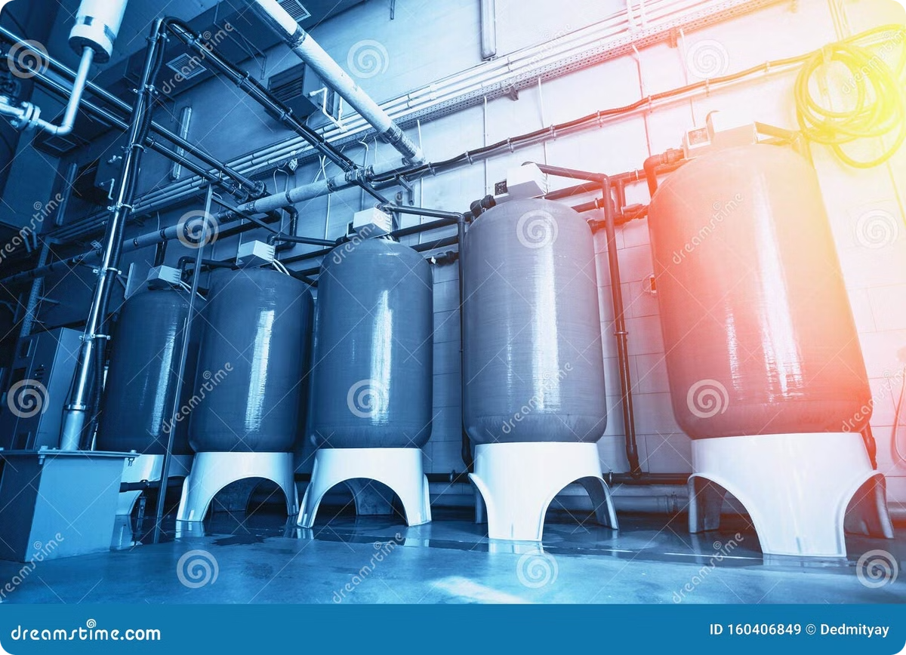
Applications of the Lime-Acid Reaction
Wastewater Treatment
Soil Amendment
Lime is used to neutralize acidic wastewater, reducing its harmful effects on the environment.
Lime is added to acidic soils to raise their pH, making them suitable for plant growth.
Chemical Synthesis
Construction
The reaction between lime and acid is utilized in the synthesis of various chemicals, including calcium salts.
Lime is used as a binder in mortar and cement, contributing to the strength and durability of concrete.

Slide 7






Safety Considerations
Eye Protection
Heat Generation
Skin Protection
Ventilation
Always wear safety goggles to prevent lime and acid splashes from damaging your eyes.
Lime reacts with water exothermically, generating heat. Handle with care.
Wear gloves and protective clothing to avoid skin contact with lime and acids.
Ensure adequate ventilation when handling lime and acids to avoid inhaling fumes.

Slide 8


Conclusion
The reaction between lime and acid is a fundamental chemical process with a wide range of applications. Understanding the chemical properties, factors influencing the reaction rate, and safety precautions is crucial for its safe and efficient use in various industries.

